Slide 1
Breast Cancer Diagnosis Using Deep Learning (CNN)
Michael Oroyo

Slide 2
Contents
Background
Data Description
Model Used
Results
Demo

Slide 3
Background
Breast cancer is a disease where cancer cells form in the tissue of the breast of the woman and can propagate to the other organs of the body
It represents the second cause of death for women after lung cancer
Early diagnosis can reduce the breast cancer mortality rate by 40%

Slide 4
Goal
To develop a program that enhances the detection and diagnosis of breast cancer faster and accurately.
Also, to detect which cancer diagnosis were benign or malignant

Slide 5
Dataset
The dataset is a Breast Cancer Histopathological Image Classification (BreakHis) composed of 9,109 microscopic images of breast tumor tissue collected from 82 patients using different magnifying factors (40X, 100X, 200X, and 400X).

Slide 6
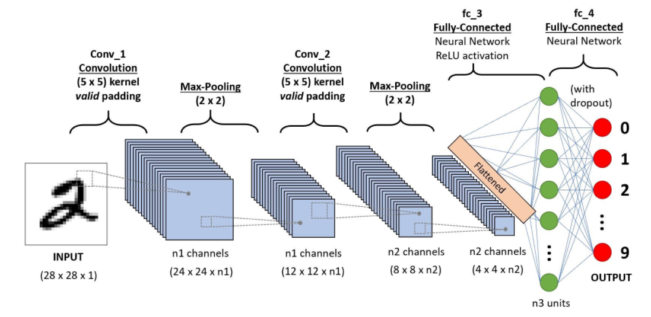
Model
A CNN architecture was used.

Slide 7
Data Preprocessing
A numpy array of zeros for labeling benign images and similarly a numpy array of ones for labeling malignant images. I also shuffled the dataset and converted the labels into categorical format.
Then split the data-set into two sets — train and test sets with 80% and 20% images respectively. Let’s see some sample benign and malignant images.
Batch size of 16 was used to train my models as it allows computational speedups from the parallelism of GPUs

Slide 8
Data Augmentation
The data was augmented in order to increase the size of the training set. Augmenting the training examples allow the network to see more diversified, but still representative data points during training.

Slide 9
Building the model
The network we’ll build will be a CNN (Convolutional Neural Network) and call it CancerNet. This network performs the following operations:
Use 3×3 CONV filters
Stack these filters on top of each other
Perform max-pooling
Use depthwise separable convolution (more efficient, takes up less memory)

Slide 10
Building the model
We use the Sequential API to build CancerNet and SeparableConv2D to implement depthwise convolutions. The class CancerNet has a static method build that takes four parameters- width and height of the image, its depth (the number of color channels in each image), and the number of classes the network will predict between, which, for us, is 2 (0 and 1).

Slide 11
Building the model
In this method, we initialize model and shape. When using channels_first, we update the shape and the channel dimension.
Now, we’ll define three DEPTHWISE_CONV => RELU => POOL layers; each with a higher stacking and a greater number of filters. The softmax classifier outputs prediction percentages for each class. In the end, we return the model.

Slide 12
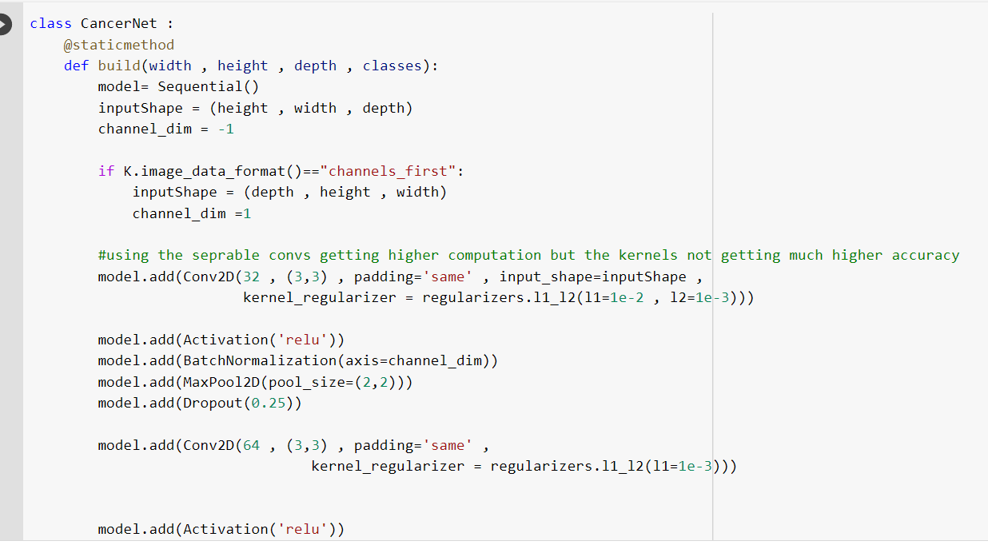
The model program

Slide 13
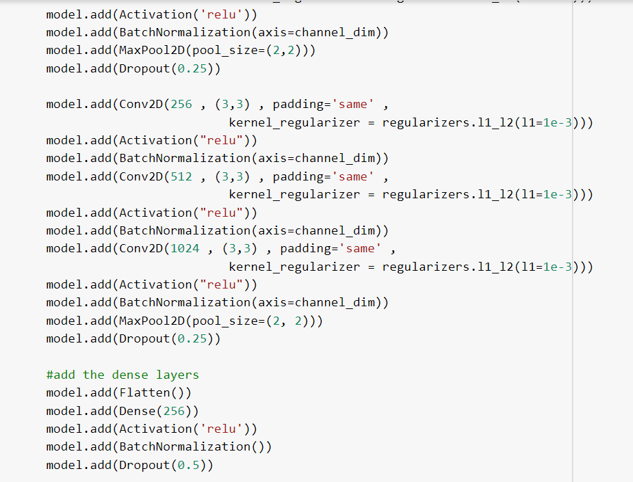
Model Program

Slide 14
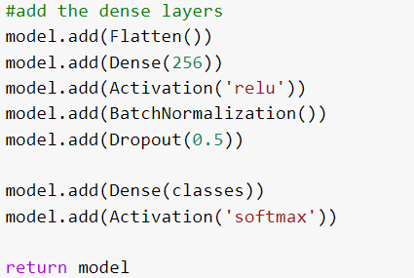
Model Program

Slide 15
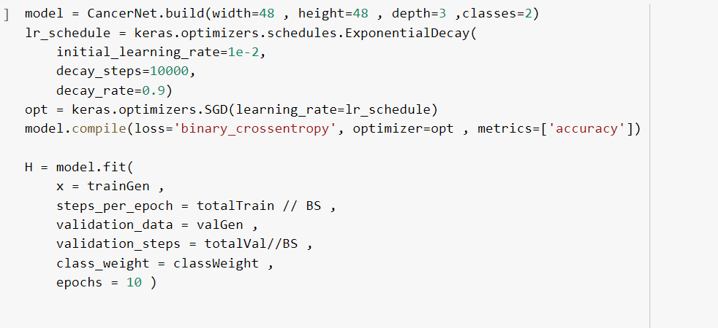
Model Accuracy script

Slide 16
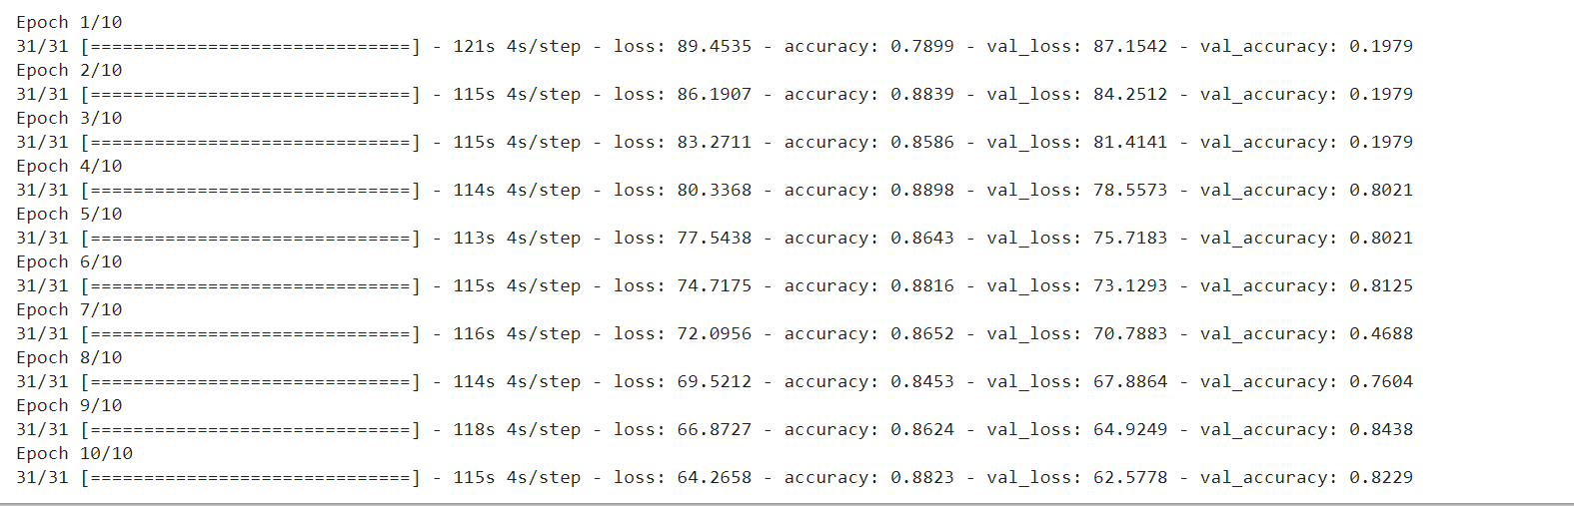
Displayed Accuracy

Slide 17
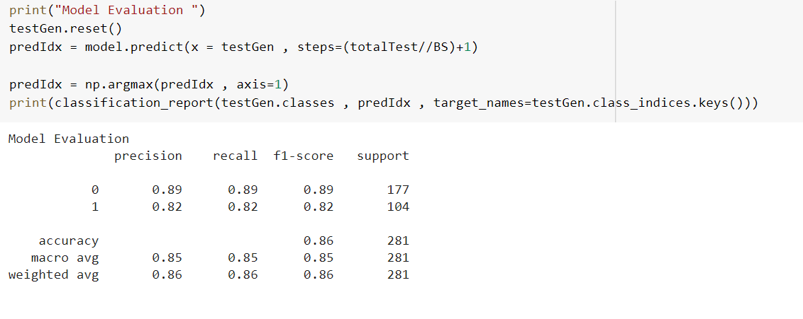
Model Evaluation

Slide 18
References
[1] A. Krizhevsky, I. Sutskever and G. E. Hinton, "Imagenet classification with deep convolutional neural
networks", Advances in neural information processing systems, pp. 1097-1105, 2012.
[2] F. A. Spanhol, L. S. Oliveira, C. Petitjean and L. Heutte, "Breast cancer histopathological image on., pp.
classification using convolutional neural networks", Neural Networks (IJCNN) 2016 International Joint
Conference 2560-2567, 2016.
[3] A. Janowczyk and A. Madabhushi, "Deep learning for digital pathology image analysis: A comprehensive
tutorial with selected use cases", Journal of natholovv informatics, vol. 7, 2016.
[4] . Araújo, G. Aresta, E. Castro, J. Rouco, P. Aguiar, C. Eloy, et al., "Classification
of breast cancer histology
images using convolutional neural networks", PloS one, vol. 12, no. 6, pp. e0177544, 2017.
[5] Lu Liangqun and Bernie Daigle, "Prognostic Analysis of Histopathological Images Using Pre-Trained
Convolutional Neural Networks", bioRxiv, 2019.

Slide 19
References
[6] Bejnordi Babak Ehteshami et al., "Diagnostic assessment of deep learning algorithms for detection of
Lymph node metastases in women with breast cancer", Jama, vol. 318, no. 22, pp. 2199-2210, 2017.
[7] Li Yi and Wei Ping, Cancer metastasis detection with neural conditional random field, 2018.
[8] Cao Hongliu et al., "Improve the performance of transfer learning without fine-tuning using and
recognition, dissimilarity-based multi-view learning for breast cancer histology images", International
conference image analysis 2018.
[9] S. Angara, M. Robinson and P. Guillén-Rondon, "Convolutional Neural Networks for Breast
Cancer Histopathological Image Classification," 2018 4th International Conference on Big
Data and Information Analytics (BigDIA), 2018, pp. 1-6, doi: 10.1109/BigDIA.2018.8632800.

Slide 20
Demo

